Slide 1
PSPACE-Completeness
Theory of Computability
Section 9.3
汇报人：赵秀锋

Slide 2
Theory of Computability
PSPACE-Completeness
The TQBF problem
The FORMULA-GAME problem
Generalized Geography

Slide 3
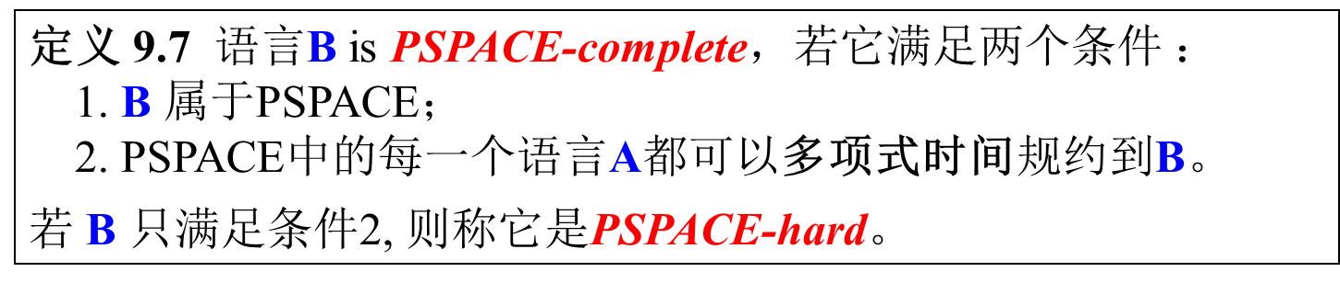
PSPACE-Completeness
9.3.a
Theory of Computability
定义 9.7 语言B is PSPACE-complete，若它满足两个条件 ：
1. B $属于$PSPACE；
2. PSPACE中的每一个语言A都可以多项式时间规约到B。
若 B 只满足条件2, 则称它是PSPACE-hard。
Why do we still appeal to polynomial time reducibility and not, say,
polynomial space reducibility, philosophically speaking?
规约是为了解决复杂的（PSPACE-、NP- 或其他）完全问题而提出的，多项式时间规约比多项式空间更简单，符合规约的目的。如果规约本身很难，它根本不能提供解决问题的简单方法。

Slide 4
The TQBF problem
9.3.b
Theory of Computability
量词：∀， ∃
对于自然数，语句∀x[x+1>x]为真。 ∃x[x+x>x]为假。
辖域：量词的作用范围。
前束范式：形如$∅=Q1x1Q2x2…Qkxk B$，$Qi为$∀或∃。
量词化布尔公式：带量词的布尔公式（必须是前束范式）。
全量词化：公式中的每个变量都出现在某一量词的辖域中。
TBQF问题就是要判断一个全量词化的布尔公式是真是假。
TQBF = {<φ>|φ 是真的全量词化的布尔公式 }
(True Quantified Boolean Formulas)

Slide 5
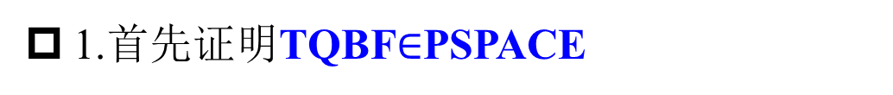
The PSPACE-completeness of TQBF
9.3.c
Theory of Computability
Theorem 9.8 TQBF is PSPACE-complete.
1.首先证明TQBF$∈$PSPACE
证明思路：为了证明TQBF属于PSPACE，只需给出一个简单的算法。该算法首先给变量赋值，然后递归的计算公式在这些值下的真值。从这些信息中算法就能确定原量化公式的真值。

Slide 6
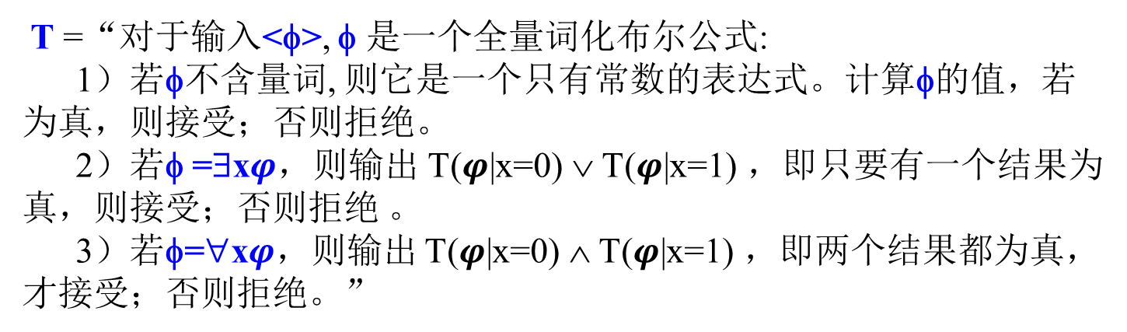
The PSPACE-completeness of TQBF
9.3.c
Theory of Computability
证明. 1.首先证明TQBF属于PSPACE
给出一个判定TQBF的多项式空间算法:
T =“对于输入<φ>, φ 是一个全量词化布尔公式:
1）若φ不含量词, 则它是一个只有常数的表达式。计算φ的值，若 为真，则接受；否则拒绝。
2）若φ =∃x$φ$，则输出 T($φ$|x=0) ∨ T($φ$|x=1) ，即只要有一个结果为真，则接受；否则拒绝
3）若φ=∀x$φ$，则输出 T($φ$|x=0) ∧ T($φ$|x=1) ，即两个结果都为真，才接受；否则拒绝。”
分析：整个过程对所有变量都赋值，若变量的个数为 m，则递归深度最多等于m，故消耗的总空间是 O(m)。因此，T在线性空间内运行。

Slide 7
The PSPACE-completeness of TQBF
9.3.c
Theory of Computability
2. 证明TQBF是PSPACE难的。
证明思路：为了证明TQBF是PSPACE难的，即PSPACE中的每个语言A在多项式时间内可归约到TQBF。从判定A的多项式空间界限图灵机开始，然后给出多项式时间规约，它把一个字符串映射为一个量词化的布尔公式φ， φ模拟机器对这个输入的计算。公式为真的充分必要条件是机器接受。

Slide 8
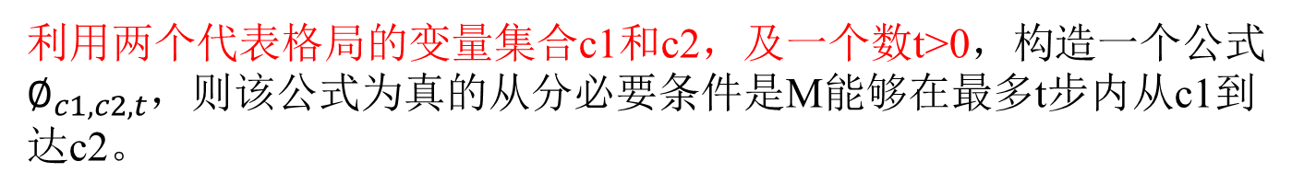
The PSPACE-completeness of TQBF
9.3.c
Theory of Computability
2. 证明TQBF是PSPACE难的。
设A是一个确定型图灵机M在多项式空间内可判定的语言。
给出一个从A到TQBF的多项式时间规约，该规约把字符串w映射为一个量词化的布尔公式φ， φ为当且仅当M接受w。
如何构造φ？
利用两个代表格局的变量集合c1和c2，及一个数t>0，构造一个公式$∅_{c1,c2,t}$，则该公式为真的从分必要条件是M能够在最多t步内从c1到达c2。
c1=c2
①若t=1，
c1一步可以转化为 c2
利用库克列文定理，把这个关系用一个move表示出来，就可以说明 c1 可以一步到达c2

Slide 9
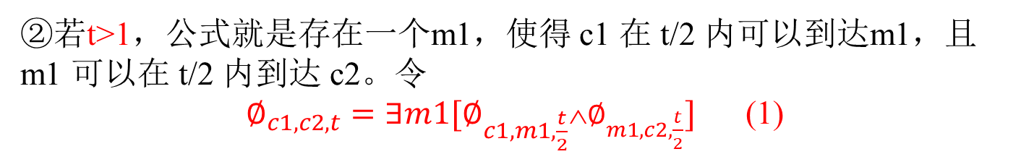
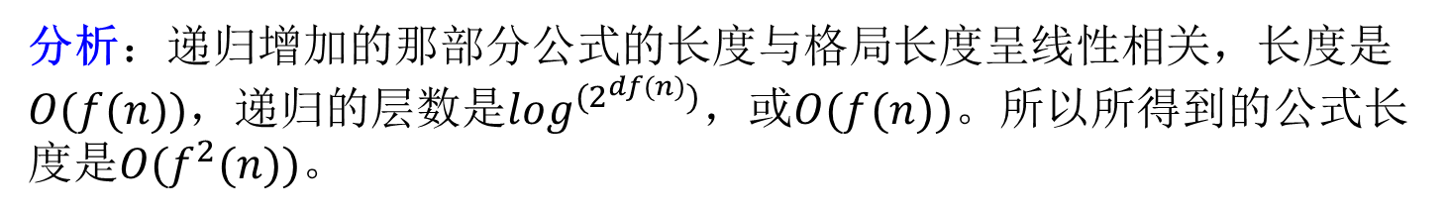
The PSPACE-completeness of TQBF
9.3.c
Theory of Computability
2. 证明TQBF是PSPACE难的。
②若t>1，公式就是存在一个m1，使得 c1 在 t/2 内可以到达m1，且m1 可以在 t/2 内到达 c2。令
$∅_{c1,c2,t}=∃m1[∅_{c1,m1,\frac{t}{2}}\text{∧}∅_{m1,c2,\frac{t}{2}}]$ (1)
重复递归构造，重复递归，直到把公式全部写出来
此公式是一个指数级长度的公式，因为递归是一个用空间换时间的算法，每次递归公式长度增加大约一倍。引入∀量词，把一个合取用全称量词来转化。
$∅_{c1,c2,t}=∃m1∀\left(c3,c4\right)∈\{\left(c1,m1\right),(m1,c2)\}[∅_{c3,c4,\frac{t}{2}}]$ (2)
分析：递归增加的那部分公式的长度与格局长度呈线性相关，长度是$O(f(n))$，递归的层数是$\log^{(2^{df(n)})}，$或$O(f(n))$。所以所得到的公式长度是$O(f^{2}(n))。$

Slide 10
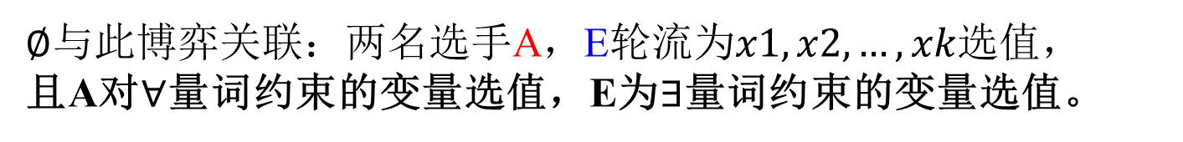

Formulas as games
9.3.d
Theory of Computability
每个全量化的布尔公式（前束范式）φ都可以看作是两个玩家A和 E之间的博弈。
给出一个前束范式的全量词化布尔表达式：
TRUE：E胜
FALSE：A胜
选手E所对应的量词
选手A所对应的量词
$$∅=∃x1∀x2∃x3…Qxk[φ]$$
选手E选值
选手A选值
对变量进行处理的语句
$∅$与此博弈关联：两名选手A，E轮流为$x1,x2,…,xk$选值，
且A对$∀$量词约束的变量选值，E为$∃$量词约束的变量选值。

Slide 11
Formulas as games
9.3.d
Theory of Computability
Examples:
∃x∀y∃z[(x∨y)∧(y∨z)∧(y∨z)]
E moves, selects x=1
∀y∃z[(1∨y)∧(y∨z)∧(y∨z)]
A moves, selects y=0
∃z[(1∨0)∧(0∨z)∧(0∨z)]
E moves, selects z=1
(1∨0)∧(0∨1)∧(0∨1)
A wins
Who has a winning strategy (a strategy that guarantees a win no matter
how the adversary acts) in this example?
--- Player A has a winning strategy: No matter what E does, select y=0.
∃x∀y∃z[(x∨y)∧(y∨z)∧(y∨z)]
(1∨0)∧(0∨1)∧(0∨1)
--- Player E has a winning strategy

Slide 12
The FORMULA-GAME problem
9.3.e
Theory of Computability
FORMULA-GAME={<φ>|在与φ关联的公式博弈中选手E有必胜策略}
Theorem 9.10 FORMULA-GAME is PSPACE-complete.
Proof .
要证明FORMULA-GAME是PSPACE-Complete 的
FORMULA-GAME = TQBF
FORMULA-GAME={<φ>|φ是真的全量词化的布尔公式}

Slide 13
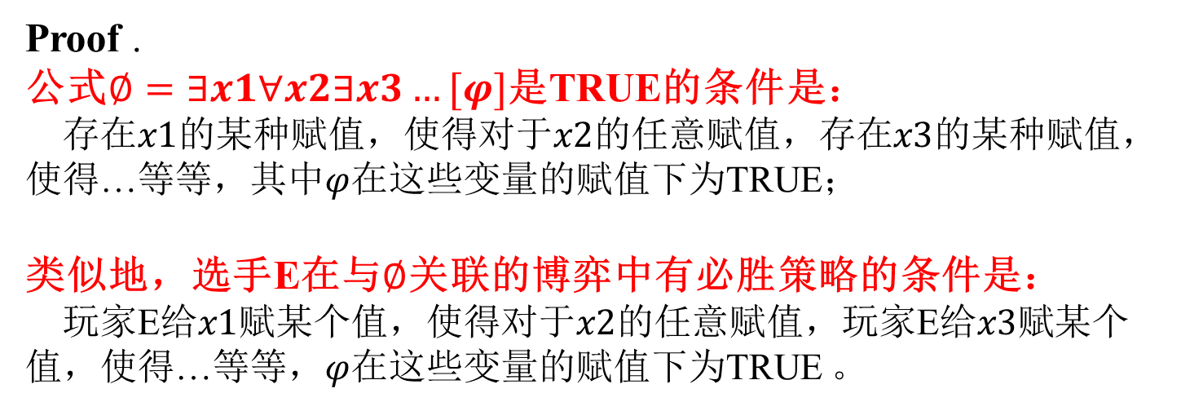
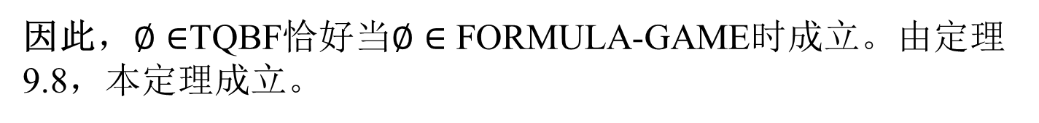
The FORMULA-GAME problem
9.3.e
Theory of Computability
Theorem 9.10 FORMULA-GAME is PSPACE-complete.
Proof .
公式$∅=∃x1∀x2∃x3…[φ]$是TRUE的条件是：
存在$x1$的某种赋值，使得对于$x2$的任意赋值，存在$x3$的某种赋值，使得…等等，其中$φ$在这些变量的赋值下为TRUE；
类似地，选手E在与$∅$关联的博弈中有必胜策略的条件是：
玩家E给$x1$赋某个值，使得对于$x2$的任意赋值，玩家E给$x3$赋某个值，使得…等等，$φ$在这些变量的赋值下为TRUE 。
同理，若公式$∅=∀x1,x2,x3∃x4,x5,∀x6[φ]，$推理也成立。
因此，$∅∈$TQBF恰好当$∅∈$ FORMULA-GAME时成立。由定理 9.8，本定理成立。

Slide 14
The child’s game Geography
9.3.f
Theory of Computability
玩家I和II轮流给世界各地的城市命名（玩家 I 开始）。
每一座选中的城市的首字母必须与前一座城市的尾字母相同，不得重复。
游戏从某指定起始城市开始，以某方无法延续而认输为止。
We can model this game with a directed graph whose nodes are the cities of the
world. There is an edge from one city to another if the first can lead to the second
according to the game rules. One node is designated as the start node/city. The condition
that cities cannot be repeated means that the path that is being spelled must be simple.
Peoria
Austin
Nashua
Albany
Orsay
...
Tokyo
Amherst
Tuscon
Oakland

Slide 15
Generalized Geography
9.3.g
Theory of Computability
In Generalized Geography, we take an arbitrary digraph with a designated start node
instead of the graph associated with the actual cities.
Who has a winning strategy here?
4
2
7
1
5
9
3
8
6

Slide 16
Generalized Geography
9.3.g
Theory of Computability
In Generalized Geography, we take an arbitrary digraph with a designated start node
instead of the graph associated with the actual cities.
Who has a winning strategy here?
4
Player I: Choose 3.
2
7
1
5
9
3
8
6

Slide 17
Generalized Geography
9.3.g
Theory of Computability
In Generalized Geography, we take an arbitrary digraph with a designated start node
instead of the graph associated with the actual cities.
Who has a winning strategy here?
4
Player I: Choose 3. II will have to choose 5.
2
7
1
5
9
3
8
6

Slide 18
Generalized Geography
9.3.g
Theory of Computability
In Generalized Geography, we take an arbitrary digraph with a designated start node
instead of the graph associated with the actual cities.
Who has a winning strategy here?
4
Player I: Choose 3. II will have to choose 5.
Now I selects 6, and II is stuck.
2
7
1
5
9
--- Player I has a winning strategy
3
8
6
4
Who has a winning strategy here?
7
Indeed, if I starts by choosing 3 as
before, II chooses 6 and wins.
2
Player II.
1
5
9
3
8
6

Slide 19
Generalized Geography
9.3.g
Theory of Computability
In Generalized Geography, we take an arbitrary digraph with a designated start node
instead of the graph associated with the actual cities.
Who has a winning strategy here?
4
Player I: Choose 3. II will have to choose 5.
Now I selects 6, and II is stuck.
2
7
1
5
9
--- Player I has a winning strategy
3
8
6
4
Who has a winning strategy here?
7
Indeed, if I starts by choosing 3 as
before, II chooses 6 and wins.
2
Player II.
1
5
9
Now assume I starts with 2.
3
8
6

Slide 20
Generalized Geography
9.3.g
Theory of Computability
In Generalized Geography, we take an arbitrary digraph with a designated start node
instead of the graph associated with the actual cities.
Who has a winning strategy here?
4
Player I: Choose 3. II will have to choose 5.
Now I selects 6, and II is stuck.
2
7
1
5
9
--- Player I has a winning strategy
3
8
6
Who has a winning strategy here?
4
Indeed, if I starts by choosing 3 as
before, II chooses 6 and wins.
Player II.
2
7
Now assume I starts with 2. Then II responds
with 4.
1
5
9
If I responds with 5, II responds with
6 and wins.
3
8
Otherwise, if I takes 7, II wins
with 9.
6
--- Player II has a winning strategy

Slide 21
GG and its PSPACE-completeness
9.3.h
Theory of Computability
GG = {<G,b> | 在图G上以节点b起始的广义地理学游戏中，选手I 有必胜策略}
Theorem 9.11 GG is PSPACE-complete.
Proof idea. 1.证明GG∈PSPACE。仿照TQBF的递归给一个多项式空间算法
M=“对输入<G,b> ，G时有向图，b是G的节点:
若b出度为0，则拒绝，选手I 立即输。
删掉节点b及与它关联的所有箭头，得到一个新图G1。
对于b原先指向的每个节点b₁,...,b_{k} ，在 < G1,b_{i}>上递归地调用M 。
若所有调用都接受，则选手II有必胜策略，所以拒绝；否则，选手I 有必胜策略，因此接受。”
分析: m 是G的节点数。
该算法只需要存放每次递归的栈，每次递归只加一个节点，最多 m 个节点，所以最多递归 m 层，因为递归的分支不是同时做的，所以空间可以复用，算法就是线性空间的。所以广义地理学问题属于 PSPACE 。

Slide 22
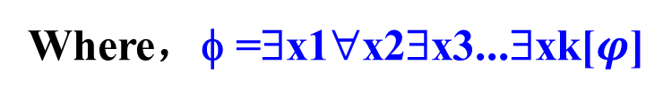
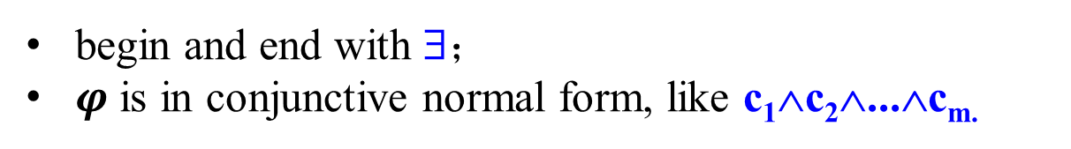
Why GG is PSPACE-hard (a)
9.3.i
Theory of Computability
Proof idea. 2.证明FORMULA-GAME多项式时间可归约到GG。
Now we describe a way how to convert (in polynomial time) φ into
<G,b> such that
φ∈FORMULA-GAME iff <G,b>∈GG,
i.e., E has a winning strategy in φ iff Player I has a winning strategy in
<G,b>.
Where，φ =∃x1∀x2∃x3...∃xk[$φ$]
begin and end with ∃；
$φ$ is in conjunctive normal form, like c₁∧c₂∧...∧c_{m.}

Slide 23
Why GG is PSPACE-hard (b)
9.3.j
Theory of Computability
1
0
The left part of G will look like this: for each
variable we create a diamond. The blue arrows
indicate Player I’s choices (turns), and the red
arrows indicate Player II’s choices in the game.
b
x₁
x₂
The left-hand choices will correspond to choosing
1 in the formula game, and the right-hand choices
correspond to choosing 0.
x₃
Then we extend this graph by adding to it the
right part as shown on the next slide for a
particular example of φ.
...
x_{k}
∃x₁∀x₂∃x₃...∃x_{k}[(x₁∨x₂∨x₃)∧(x₂∨x₃∨...)∧...∧(...)]
∃x₁∀x₂∃x₃∀x₄... ∃x_{k}[c₁∧c₂∧...c_{m}]

Slide 24
Why GG is PSPACE-hard (c)
9.3.j
Theory of Computability
1
0
Suppose E has a winning
strategy in φ. Then, let Player I
follow the “same” strategy in
the left part of the graph.
Whatever c_{i} is chosen by
Player II, it is a true clause
and thus has a true literal. Let
then Player I choose such a
true literal. Then Player II is
stuck, as the path has already
passed through the
corresponding left or right
node of the corresponding
diamond. So, Player I has a
winning strategy in G.
b
x₁
x₁
x₂
c₁
x₃
x₂
x₂
x₃
c₂
c
x₃
...
...
c_{m}
x_{k}
∃x₁∀x₂∃x₃...∃x_{k}[(x₁∨x₂∨x₃)∧(x₂∨x₃∨...)∧...∧(...)]
∃x₁∀x₂∃x₃∀x₄... ∃x_{k}[c₁∧c₂∧...c_{m}]

Slide 25
Why GG is PSPACE-hard (d)
9.3.j
Theory of Computability
1
0
Suppose now A has a winning
strategy in φ. Then, let it
follow the “same” strategy in
the left part of the graph.
Then there is a false clause c_{i},
and let Player II choose that
clause. Now, whatever literal
of c_{i} is chosen by Player I, it
is a false literal and hence the
path has not passed through it.
So, Player II is not stuck, and
goes to the corresponding left
or right node of the
corresponding diamond. Now
Player I is stuck. Thus, II has
a winning strategy in G.
b
x₁
x₁
x₂
c₁
x₃
x₂
x₂
x₃
c₂
c
x₃
...
...
c_{m}
x_{k}
∃x₁∀x₂∃x₃...∃x_{k}[(x₁∨x₂∨x₃)∧(x₂∨x₃∨...)∧...∧(...)]
∃x₁∀x₂∃x₃∀x₄... ∃x_{k}[c₁∧c₂∧...c_{m}]

